Slide 1
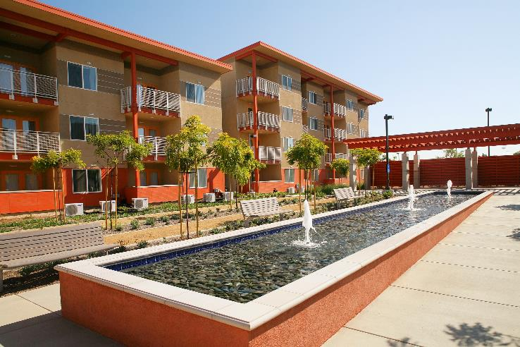
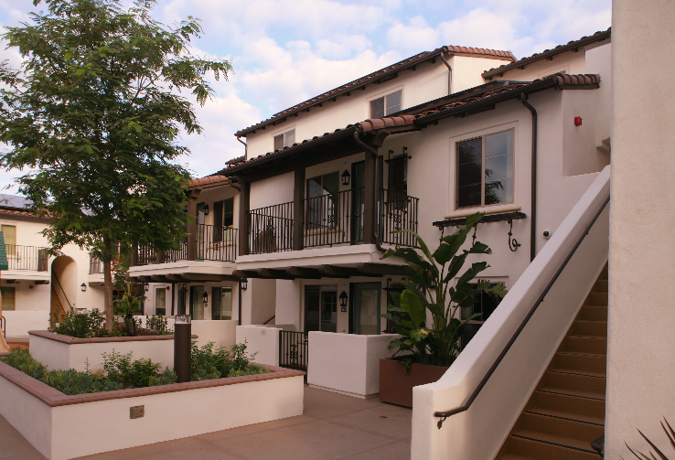
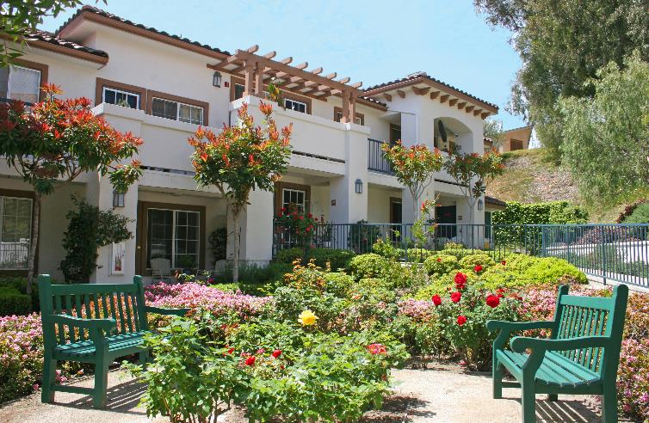
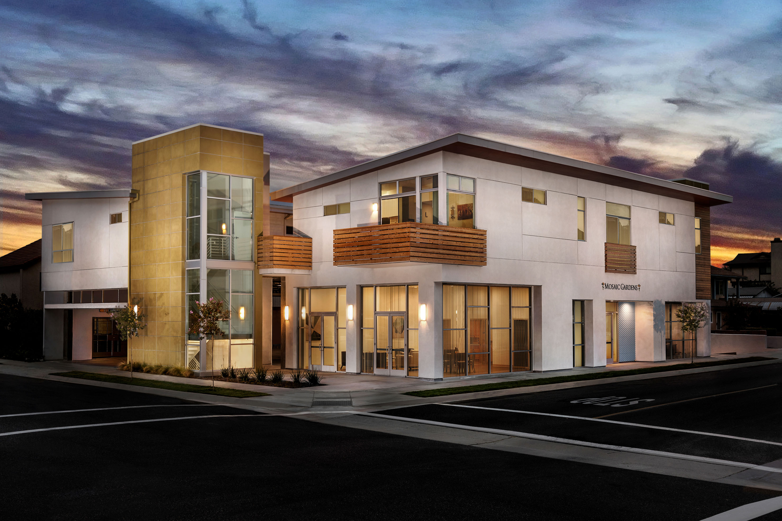
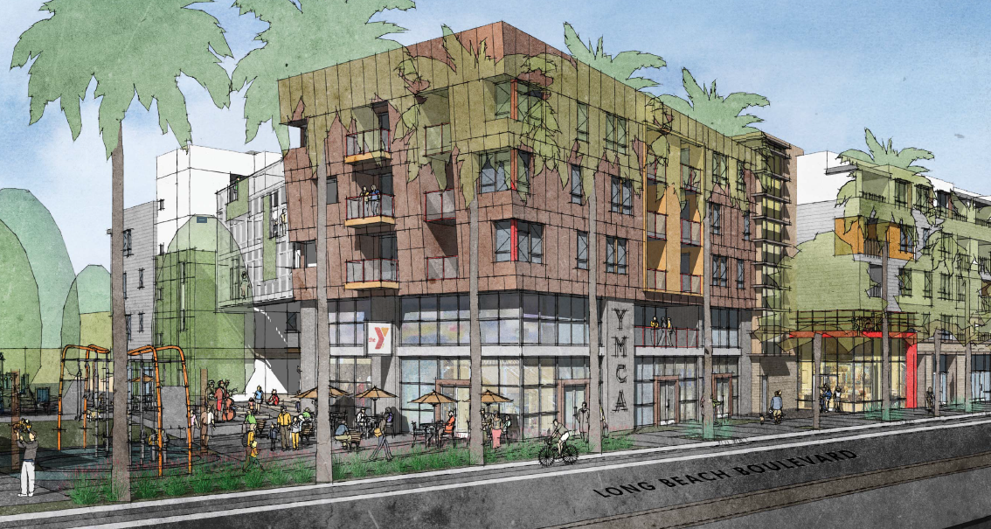
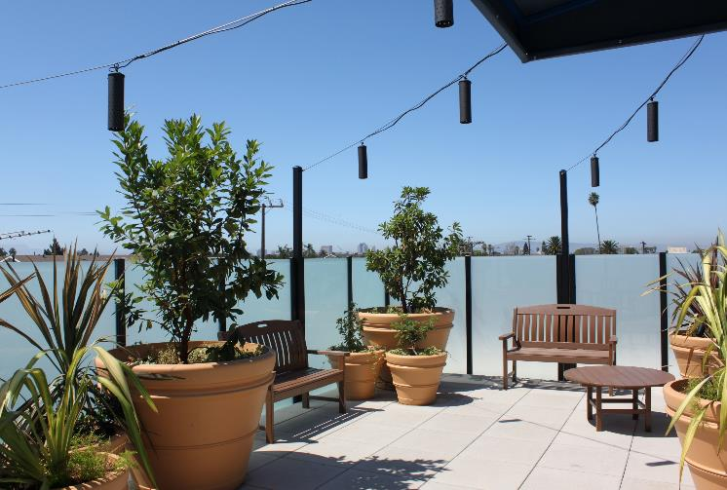
The Spark at Midtown

Slide 2
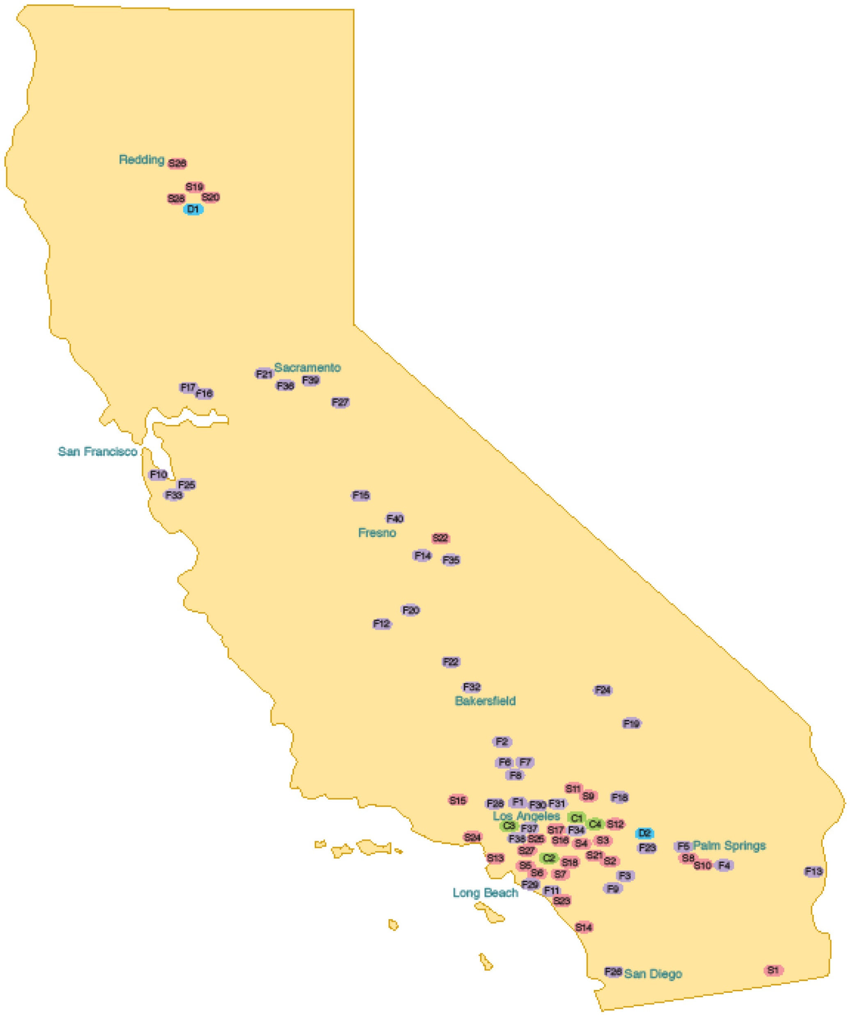
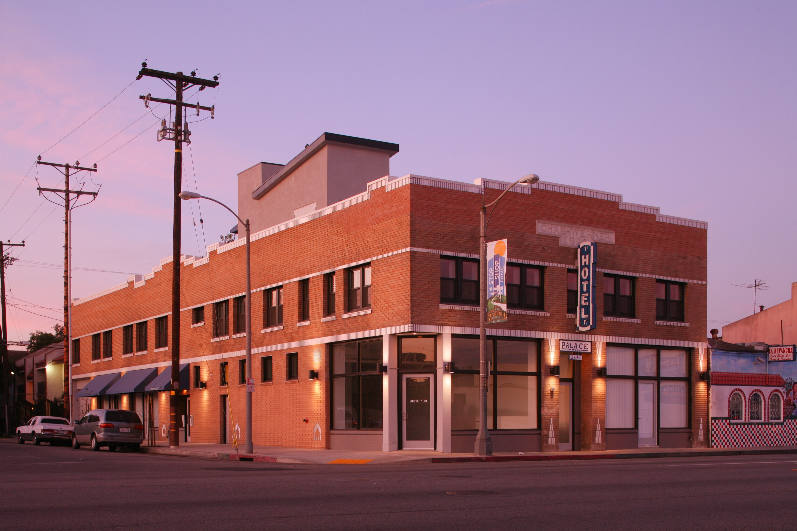
LINC Housing - Our Mission
LINC Housing: Long Beach Based, Mission-Driven

Slide 3
LINC by the Numbers
8,000 |  | units developed
5,500 |  | units under management
1,400 |  | units in development
35 |  | years in business
$380 million |  | in funding awards in last five years

Slide 4
A Broad Approach to Community Development
Community Development
Civic Engagement
Health Care
Education
Jobs
Housing
Environmental

Slide 5
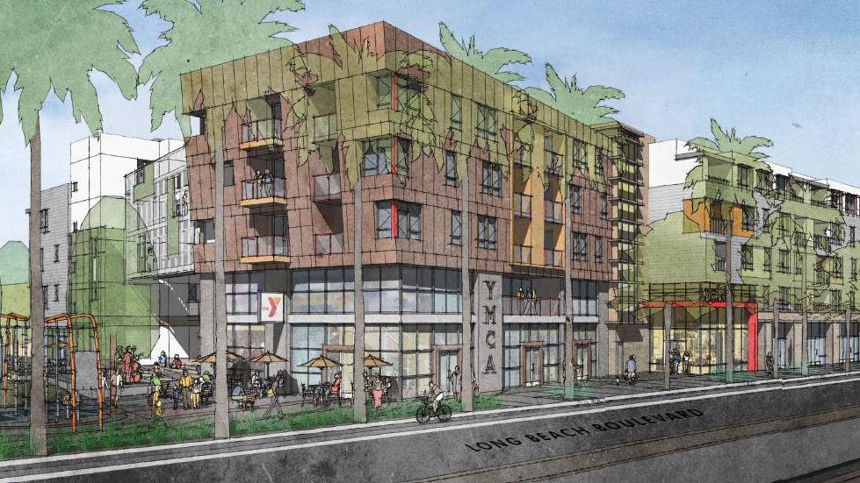
95 Units
Vibrant mixed-use connecting community assets
Community parklet
The Spark at Midtown

Slide 6
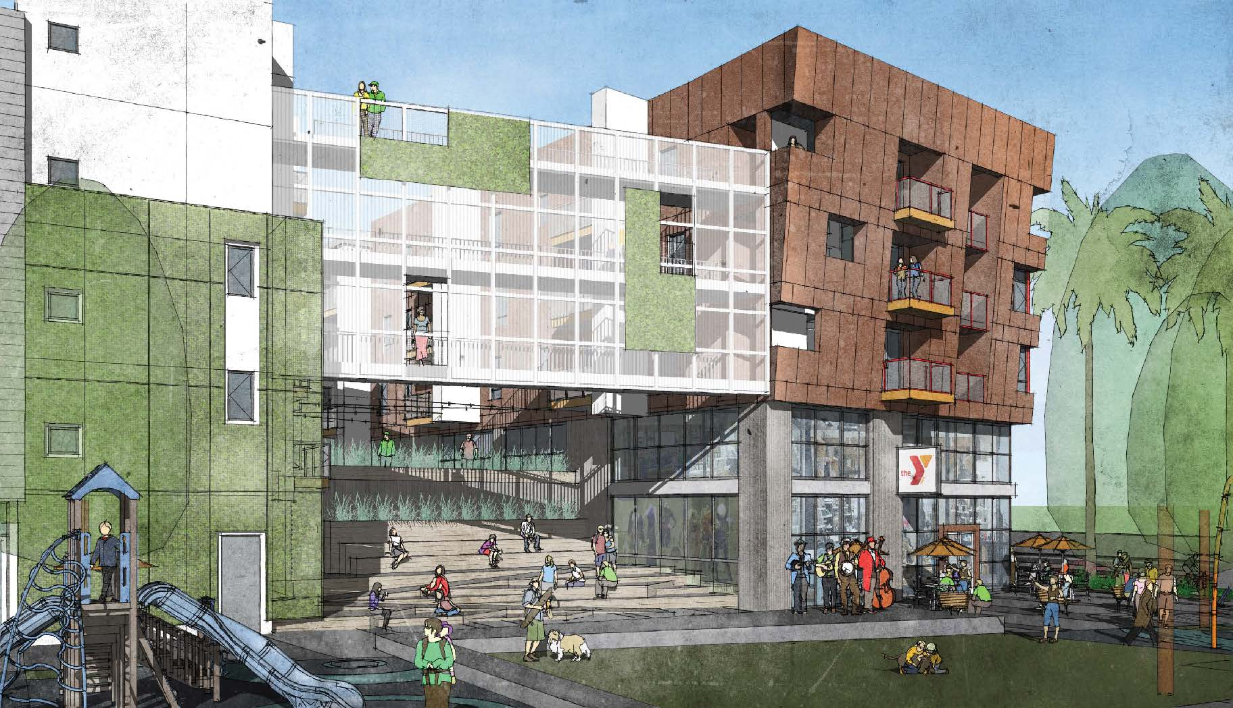

Slide 7
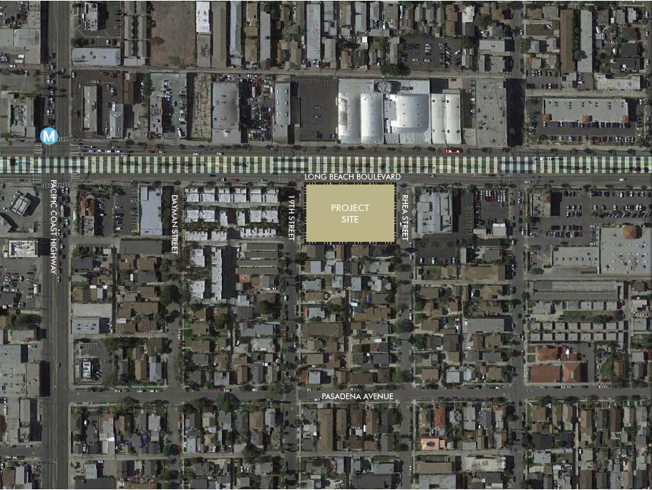
1900 Long Beach Blvd., Long Beach, CA

Slide 8
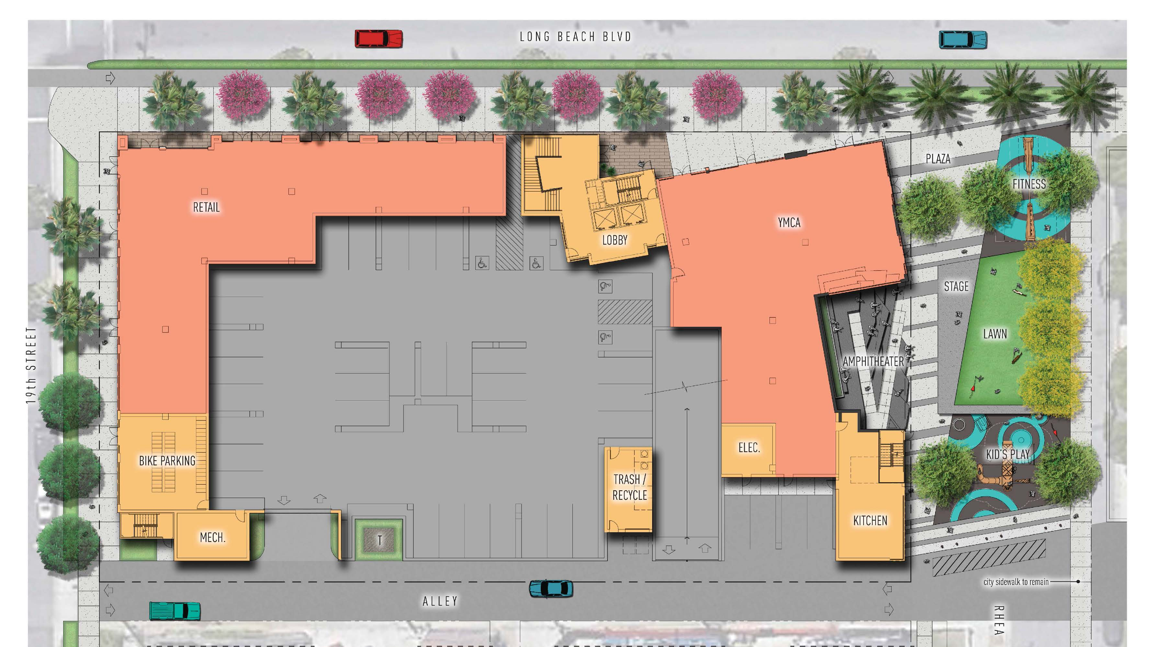
St. Mary’s Clinic
Change Agent
Productions
MHA Cafe
Flex Meeting
Space

Slide 9
The Spark at Midtown Priority Areas
Housing
Education
Jobs

Slide 10
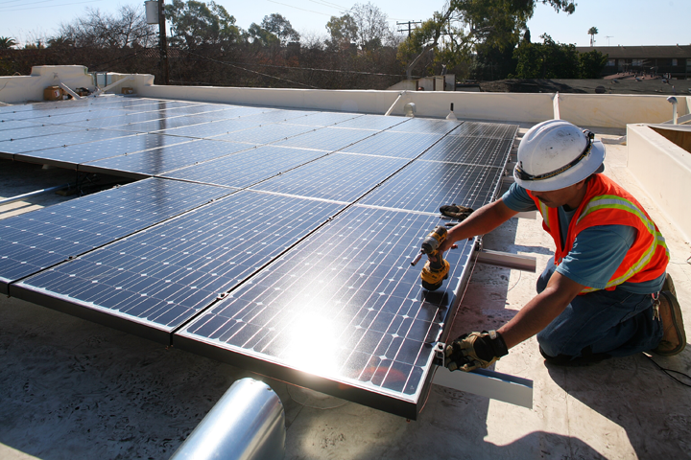
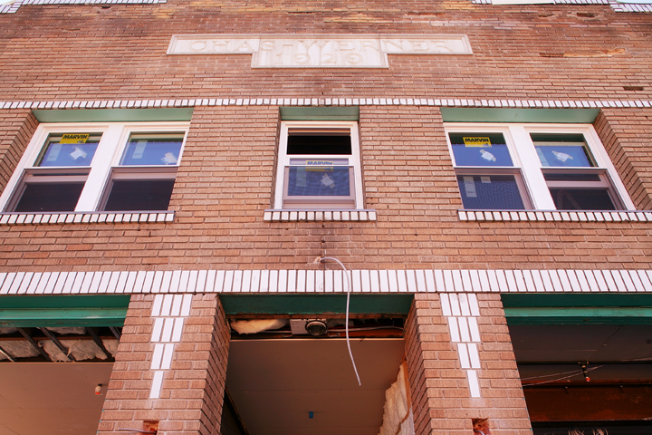

Local Economy Impact
During Construction:
788 New jobs created
$17.7 million in local business revenue
$39.6 million created in local wages/salaries
$10.8 million in local taxes and fees
Spark at Midtown: 153 new jobs *Estimated
* Figures estimated from the National Association of Home Builders’ report
The Economic Impact of Home Building in a Typical Local Area (April 2015).

Slide 11
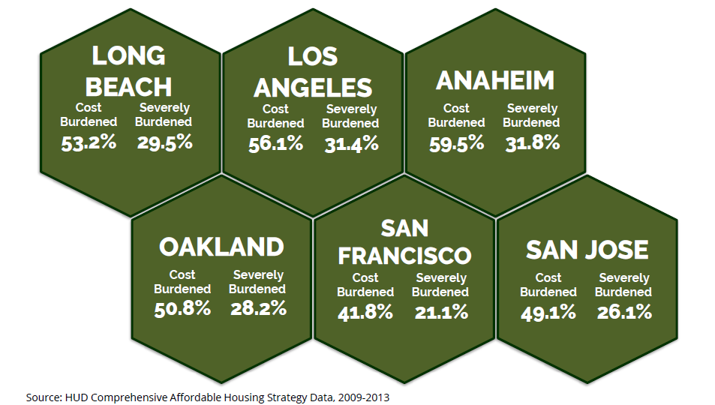
Our Mission: Building Communities & Transforming Neighborhoods through Housing
As a percentage of income, Long Beach rents are more expensive than San Francisco

Slide 12
Affordability
Unit # | Unit Type | Gross Rent | Affordability
47 | 1 bedroom | $415-$545 | 30%-60% AMI
24 | 2 bedroom | $654-$1,309 | 30%-60% AMI
24 | 3 bedroom | $756-$1,512 | 30%-60% AMI
1 | Manager’s Unit | 0
Total | 95
*AMI= Area Median Income
*AMI in LA County in 2017 was $64,000
*AMI in Long Beach in 2017 was $60,000

Slide 13
Sources
Permanent Financing Sources
Los Angeles County Funds | $9,220,000
Los Angeles County 4th District General Funds | $1,500,000
City of Long Beach Loan | $3,000,000
HCD Infill Infrastructure Grant (IIG) | $1,999,268
Federal Home Loan Bank – Affordable Housing Program Grant | $940,000
Permanent Loan | $10,317,700
Limited Partner Equity (Tax Credit Equity) | $24,112,992
Other | $1,487,161
Total | $52,577,121

Slide 14
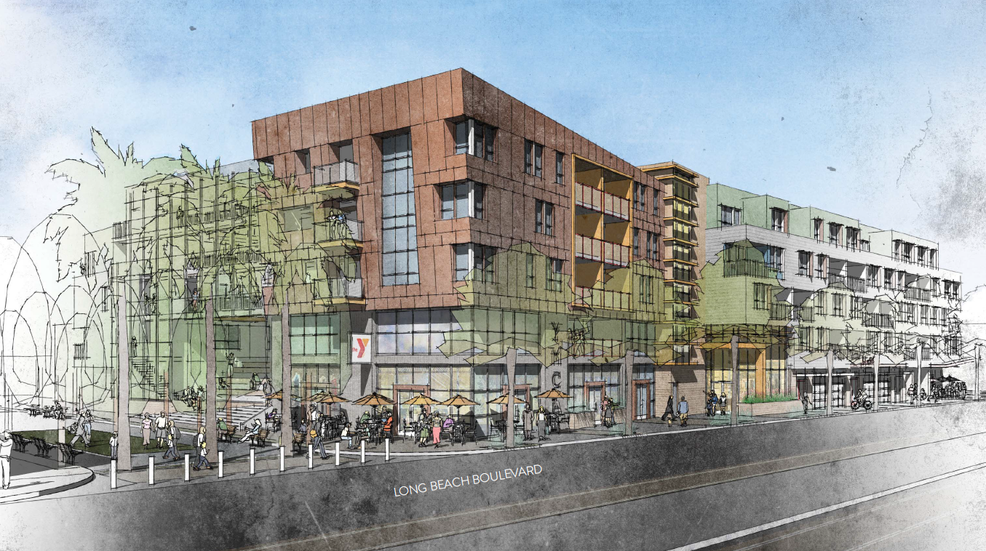
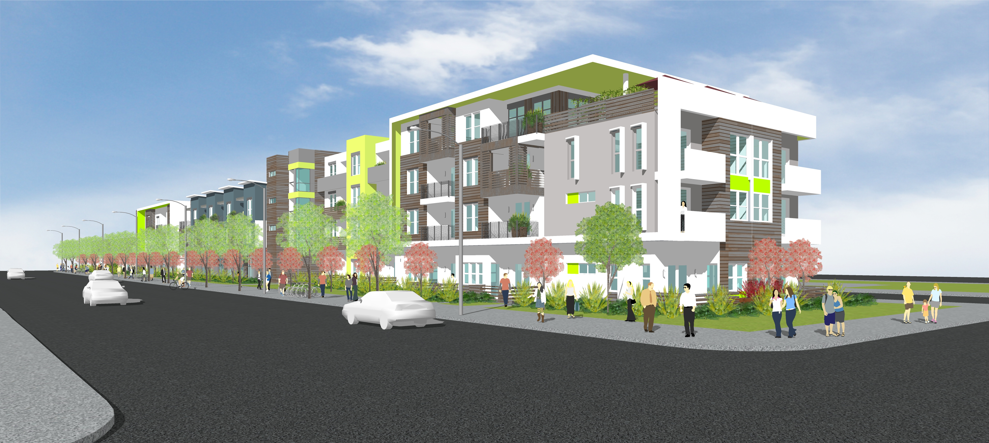
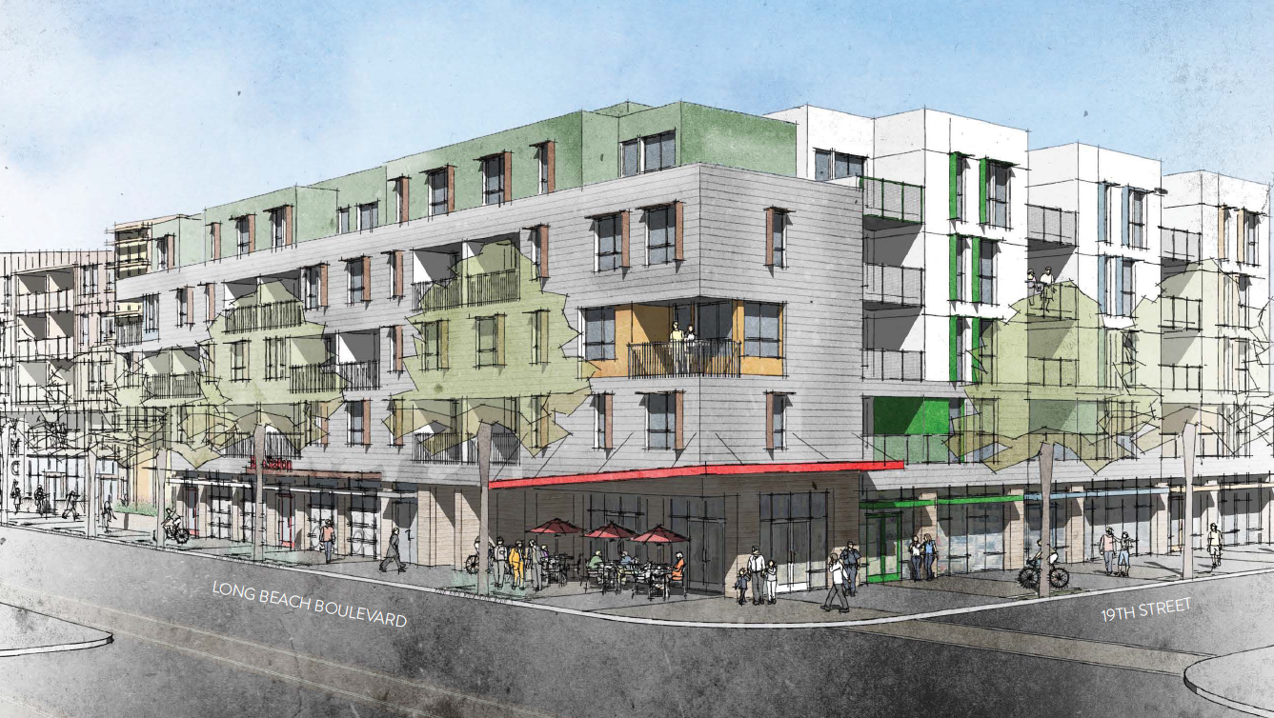
Questions and Discussion
Ana Tapia, Project Manager
LINC Housing Corporation
(562) 684-1114
For information on applying for the project contact:
Long Beach Housing Authority
www.longbeach.gov/haclb/programs/hopwa/waiting-list/
(562) 570-6985

